Slide 1
Towards Dependent Types for JavaScript
Ravi Chugh, David Herman, Ranjit Jhala
University of California, San Diego
Mozilla Research

Slide 2
Towards Dependent Types for JavaScript
Explicit
Decidable
A Large Subset of
Features Common to All Editions

Slide 3
Outline
Challenges
Our Approach
Preliminary Results

Slide 4
Challenge 1: Reflection
function negate(x) {
if (typeof x == “number”)
return 0 - x
else
return !x
}
x should be “num-or-bool”

Slide 5
Challenge 2: Mutation
function negate(x) {
if (typeof x == “number”)
x = 0 - x
else
x = !x
return x
}
Different types stored in x

Slide 6
Challenge 3: Coercions
3 + 4 // 7
“3” + “4” // “34”
3 + “4” // “34”

Slide 7
Challenge 3: Coercions
!true // false
!1 // false
!“” // true

Slide 8
Challenge 3: Coercions
0 === 0 // true
0 === “” // false
0 == “” // true

Slide 9
Challenge 4: Objects
var par = {} var child = Obj.create(par) child.f = 1
var g = “g” child[g] = 2 child.g // 2
child.h // undefined par.h = 3 child.h // 3
Mutable
Dynamic Keys
Prototypes

Slide 10
Challenge 5: Arrays
Finite or Unknown “Length”
var nums = [0,1,2] nums[0] + nums[1] + nums[2]
delete nums[1]
for (i=0; i < nums.length; i++) sum += nums[i]
nums.push(42)
“Packed” or “Unpacked”
Prototype-based

Slide 11
Prior Approaches
Usability
F≤
∨, ∧
refinement types
occurrence types
…
syntactic types
dependent types
Coq
The JS Wall
Expressivity

Slide 12
Outline
Challenges
Our Approach
Preliminary Results

Slide 13
Our Approach
Dependent JavaScript [in submission]
System D [POPL ’12]
Usability
F≤
∨, ∧
refinement types
+ nesting
occurrence types
+ this talk
…
syntactic types
dependent types
Coq
The JS Wall
Expressivity

Slide 14
Refinement Types
{ x | p }
“value x such that formula p is true”
Bool ≡
{ b | tag(b) = “boolean” }
Num ≡
{ n | tag(n) = “number” }
Int ≡
{ i | tag(i) = “number” ∧ integer(i) }
Any ≡
{ x | true }

Slide 15
Refinement Types
{ x | p }
“value x such that formula p is true”
3 ::
Num
3 ::
Int
3 ::
{ i | i > 0 }
3 ::
{ i | i = 3 }

Slide 16
Subtyping is Implication
{ i | i = 3 } <: { i | i > 0 } <: Int <: Num
⇒ i = 3
⇒ i > 0
⇒ tag(i) = “number” ∧ integer(i)
⇒ tag(i) = “number”

Slide 17
Subtyping is Implication
Type
Checker
Logical
Solver
Annotated
Program

Slide 18
System D [POPL 2012]
var obj = { “n”: 17, “f”: function (i) { return i + 5 }}
obj ::
{ d | tag(d) = “Dict”
∧ tag(sel(d,“n”)) = “number”
∧ sel(d,“f”) :: Int → Int }
McCarthy’s decidable theory of arrays
Great for dictionaries of base values

Slide 19
System D [POPL 2012]
var obj = { “n”: 17, “f”: function (i) { return i + 5 }}
obj ::
{ d | tag(d) = “Dict”
∧ tag(sel(d,“n”)) = “number”
∧ sel(d,“f”) :: Int → Int }
Type constructors in formulas
Subtyping algorithm retains precision and decidability
Uninterpreted “has-type” predicate

Slide 20
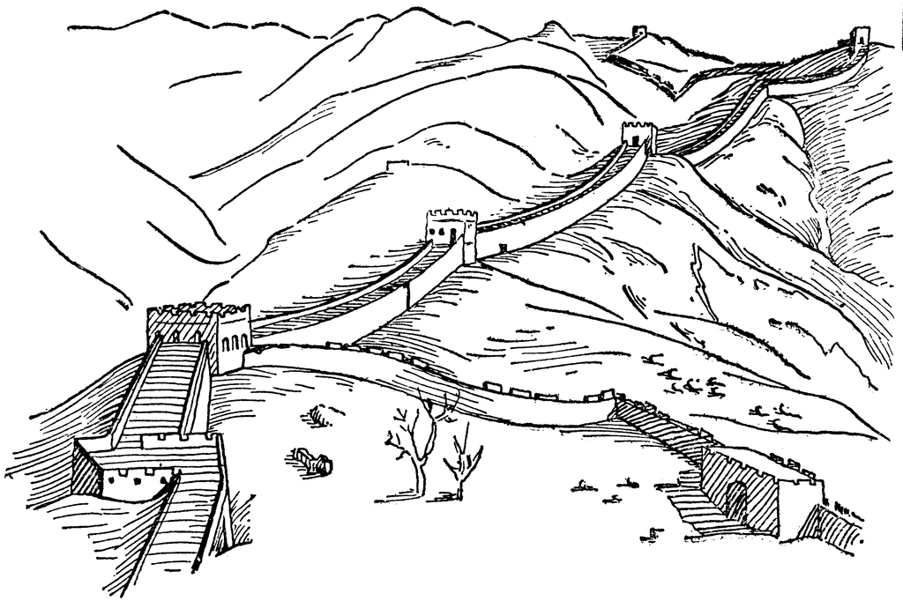
System D [POPL 2012]
Dependent JavaScript (DJS)
photo courtesy of ClipArt ETC

Slide 21
System D [POPL 2012]
+ Types for JS Primitives
+ Strong Updates
+ Prototype Inheritance
+ Arrays
Dependent JavaScript (DJS)

Slide 22
System D [POPL 2012]
+ Types for JS Primitives
+ Strong Updates
+ Prototype Inheritance
+ Arrays
Dependent JavaScript (DJS)

Slide 23
Primitives
Strong Updates
Prototypes
Arrays
+ Types for JS Primitives
+ Strong Updates
+ Prototype Inheritance
+ Arrays

Slide 24
Primitives
Strong Updates
Prototypes
Arrays
Choose degree of precision and coercion
! :: Bool → Boolalse
then b = true
else b = false }

Slide 25
Primitives
Strong Updates
Prototypes
Arrays
Choose degree of precision and coercion
! :: x:Bool → { b | if x = false
then b = true
else b = false }

Slide 26
Primitives
Strong Updates
Prototypes
Arrays
Choose degree of precision and coercion
! :: x:Any → { b | if falsy(x)
then b = true
else b = false }
falsy(x) ≡
x = false ∨ x = 0 ∨ x = null ∨ x = “” ∨ x = undefined ∨ x = NaN

Slide 27
Primitives
Strong Updates
Prototypes
Arrays
function negate(x) {
if (typeof x == “number”)
x = 0 - x
else
x = !x
return x
}
Flow Sensitive
Path Sensitive
(even with ordinary refinement types)
NumOrBool → NumOrBool
x:NumOrBool → { y | tag(y) = tag(x) }

Slide 28
Primitives
Strong Updates
Prototypes
Arrays
var grandpa = …,
parent = Object.create(grandpa),
child = Object.create(parent),
b = k in child,
Key Membership via Prototype Chain Unrolling
b ::
{ v | v = true iff
(has(child,k) ∨
(has(parent,k) ∨
(has(grandpa,k) ∨
(HeapHas(H,great,k)) }
child
parent
grandpa
H (Rest of Heap)
great

Slide 29
Primitives
Strong Updates
Prototypes
Arrays
var grandpa = …,
parent = Object.create(grandpa),
child = Object.create(parent),
b = k in child,
x = child[k]
Key Lookup via Prototype Chain Unrolling
x ::
{ v | if has(child,k) then v = sel(child,k)
{ v | elif has(parent,k) then v = sel(parent,k)
{ v | elif has(grandpa,k) then v = sel(grandpa,k)
{ v | elif HeapHas(H,great,k)) then v = HeapSel(H,great,k))
{ v | else v = undefined }

Slide 30
Primitives
Strong Updates
Prototypes
Arrays
Key Idea
Reduce prototype semantics
to decidable theory of arrays
via flow-sensitivity and unrolling

Slide 31
Primitives
Strong Updates
Prototypes
Arrays
Track types, “packedness,” and length of arrays where possible
-1
0
1
2
len(a)
{ a | a :: Arr(T)
{ a |∧ packed(a)
{ a |∧ len(a) = 10 }
…
T?
T?
T?
T?
…
T?
T?
…
…
X
T
T
T
…
T
X
…
T? ≡ { x | T(x) ∨ x = undefined }
X ≡ { x | x = undefined }

Slide 32
Primitives
Strong Updates
Prototypes
Arrays
Encode tuples as arrays
var tup = [17, “ni hao”]
{ a | a :: Arr(Any)
{ a |∧ packed(a) ∧ len(a) = 2
{ a |∧ Int(sel(a,0))
{ a |∧ Str(sel(a,1)) }

Slide 33
Primitives
Strong Updates
Prototypes
Arrays
Re-use prototype mechanism
var tup = [17, “ni hao”]
tup.push(true) a
{ a | a :: Arr(Any)
{ a |∧ packed(a) ∧ len(a) = 3
{ a |∧ … }

Slide 34
Recap of DJS Tricks
Uninterpreted Functions
Flow Sensitivity
Prototype Unrolling
Refinement Type Encodings

Slide 35
Outline
Challenges
Our Approach
Preliminary Results

Slide 36
Implementation
DJS Program
~6 KLOC OCaml
Desugarer Based on Guha et al. [ECOOP ’10]
Type
Checker
Z3 SMT Solver
Desugared
Program

Slide 37
Benchmarks
DJS Program
Mainly SunSpider and JSGP
300 Unannotated LOC
70% Annotation overhead
9 Benchmarks run in <3s
4 Benchmarks run in 8-52s
Desugarer Based on Guha et al. [ECOOP ’10]
Type
Checker
Z3 SMT Solver
Desugared
Program

Slide 38
Evaluation
DJS Program
All parts of type system used
Can optimize patterns during desugaring
Can optimize patterns during type checking
Desugarer Based on Guha et al. [ECOOP ’10]
Type
Checker
Z3 SMT Solver
Desugared
Program

Slide 39
Conclusion
DJS is a step towards climbing the JS Wall

Slide 40
Thanks!
ravichugh.com/nested
github.com/ravichugh/djs
D
::

Slide 41
{p} ≡ {v|p}
/*: x:NumOrBool → {ite Num(x) Num(v) Bool(v)} */
function negate(x) {
x = (typeof x == “number”) ? 0 – x : !x
return x
}
/*: x:Any → {v iff falsy(x)} */
function negate(x) {
x = (typeof x == “number”) ? 0 – x : !x
return x
}

Slide 42
Function Types and Objects
x:T₁/H₁ → T₂/H₂
input type
output heap
input heap
output type
ObjHas(d,k,H,d’) ≡ has(d,k) ∨ HeapHas(H,d’,k)
/*: x:Ref / [x |-> d:Dict |> ^x]
→ {v iff ObjHas(d,”f”,curHeap,^x)} / sameHeap */
function hasF(x) {
return “f” in x
}

Slide 43
Function Types and Objects
x:T₁/H₁ → T₂/H₂
input type
output heap
input heap
output type
ObjSel(d,k,H,d’) ≡
ite has(d,k) sel(d,k) HeapSel(H,d’,k)
/*: x:Ref / [x |-> d:Dict |> ^x]
→ {v = ObjSel(d,”f”,curHeap,^x)} / sameHeap */
function readF(x) {
return x.f
}

Slide 44
Q: What is “Duck Typing”?
Structural Object Types
+
Logical Reasoning
?

