Slide 1
Using Types For
Software Verification
Ranjit Jhala, UC San Diego
(with Pat Rondon, Ming Kawaguchi)

Slide 2
Once Upon a time …
char* rev_copy(char* a, int n){
i = 0;
j = n – 1;
b = malloc(n);
while(0<=j){
b[i] = a[j];
i++;
j--;
}
return b;
}

Slide 3
Memory Safety Verification
char* rev_copy(char* a, int n){
i = 0;
j = n – 1;
b = malloc(n);
while(0<=j){
b[i] = a[j];
i++;
j--;
}
return b;
}
Access Within Array Bounds

Slide 4
char* rev_copy(char* a, int n){
i = 0;
j = n – 1;
b = malloc(n);
while(j>=0){
b[i] = a[j];
i++;
j--;
}
return b;
}
0:
0: i = 0;
j = n–1;
1: while (0<=j){
2: assert(i<n);
i = i+1;
j = j–1;
}
1:
2:
assert (i<n);
assert (0<=i && i<n);
Access Within Array Bounds
How to prove assert never fails ?

Slide 5
How to prove asserts?
Invariants [Floyd-Hoare]

Slide 6
Invariants
Invariant Proves Assert
true
0: i = 0;
j = n–1;
1: while (0<=j){
2: assert(i<n);
i = i+1;
j = j–1;
}
Predicate that is always true
@ Program Location
i+j=n-1
i+j=n-1 Æ 0·j

Slide 7
How to Find Invariants?
How to Prove Asserts?

Slide 8
What are Invariants ?
?
0: i = 0;
j = n–1;
1: while (0<=j){
2: assert(i<n);
i = i+1;
j = j–1;
}
?
?

Slide 9
What are Invariants ?
Let X_{i} = Invariant @ location i

Slide 10
What are Invariants ?
?
X₀
0: i = 0;
j = n–1;
1: while (0<=j){
2: assert(i<n);
i = i+1;
j = j–1;
}
X₁
?
Properties of X₀,X₁,X₂?
X₂
?

Slide 11
What are Invariants ?
X₀
0: i = 0;
j = n–1;
1: while (0<=j){
2: assert(i<n);
i = i+1;
j = j–1;
}
X₀= true
Initial Values Arbitrary

Slide 12
What are Invariants ?
true
0: i = 0;
j = n–1;
1: while (0<=j){
2: assert(i<n);
i = i+1;
j = j–1;
}
X₁
i=0 Æ j=n-1 ) X₁

Slide 13
What are Invariants ?
0: i = 0;
j = n–1;
1: while (0<=j){
2: assert(i<n);
i = i+1;
j = j–1;
}
X₁
X₂
0·j Æ X₁ ) X₂

Slide 14
What are Invariants ?
0: i = 0;
j = n–1;
1: while (0<=j){
2: assert(i<n);
i = i+1;
j = j–1;
}
X₂
X₂ ) i<n

Slide 15
What are Invariants ?
0: i = 0;
j = n–1;
1: while (0<=j){
2: assert(i<n);
i = i+1;
j = j–1;
}
X₁
X₂
i=i_{o}+1 Æ j=j_{o}-1 Æ [i_{o}/i][j_{o}/j]X₂ ) X₁

Slide 16
What are Invariants ?
Predicates X₁, X₂ s.t.
i=0 Æ j=n-1 ) X₁
0·j Æ X₁ ) X₂
X₂ ) i<n
… Æ [i_{o}/i][j_{o}/j]X₂ ) X₁

Slide 17
How to Find Invariants?
Solve for X₁, X₂...
(or, #yourfavoriteabstractinterpretation)
Via SMT + Pred. Abstraction

Slide 18
Recap
Safety
Invariants
X₀ , X₁
Implications
X₀ ) X₁
AI, PA, CEGAR,…

Slide 19
Plan
Classic SW Verification
is hard to automate.
Types offer automation
and expressiveness too!

Slide 20
So, what’s hard?

Slide 21
int kmp_search(char str[], char pat[]){
p = 0; s = 0;
while (p<pat.length && s<str.length){
if (str[s] == pat[p]){s++; p++;}
else if (p == 0){s++;}
else{p = table[p-1] + 1;}
}
if (p >= plen) {return (s-plen)};
return (-1);
}
Need Universally Quantified Invariants
Every element of table exceeds -1
8i: 0·i<table.length )-1·table[i]
Prove Access Within Array Bounds

Slide 22
Need Universally Quantified Invariants
More complex for lists, trees, etc.
8x: next*(root,x) ) -1 · x.data

Slide 23
Quantifiers Kill SMT Solvers

Slide 24
Quantifiers Kill SMT Solvers
How to Generalize and Instantiate?

Slide 25
Key: Invariants Without Quantifiers

Slide 26
Plan
Classic SW Verification
is hard to automate.
Types offer automation
and expressiveness too!

Slide 27
Idea: Liquid Types
Idea: Logically Qualified Types
Factor Invariant to Logic x Type

Slide 28
Logic
Describes Individual Data
Type
Quantifies over Structure

Slide 29
8i: 0 ·i<table.length )-1· table[i]
Logic
Type
factored into
table :: {v:int|-1 · v} array

Slide 30
8x: next*(root,x) )-1 · x.data
Logic
Type
factored into
root :: {v:int|-1 · v} list

Slide 31
Logic
Describes Individual Data
Theorem Prover
Reasoning about Individual Data
Type System
Quantified Reasoning about Structure
Type
Quantifies over Structure

Slide 32
Demo
“Map-Reduce”

Slide 33
“Map-Reduce”
map :: (e -> (k, v) list)
-> e list
-> (k, v) list
group :: (k, v) list
-> (k, v list) table
reduce :: (v -> v -> v)
-> (k, v list) table
-> (k, v) table

Slide 34
K-Means Clustering

Slide 35
0. Choose K Centers Arbitrarily

Slide 36
1. (Map) Points to Nearest Center

Slide 37
2. (Group) Points by Center

Slide 38
3. (Reduce) Centroids into New Centers

Slide 39
Repeat 1,2,3 Until Convergence

Slide 40
Demo
K-Means via Map-Reduce

Slide 41
Base Types
Collections
Closures
Generics

Slide 42
Type of f
int ! unit
Template of f
{v:int|X₁}!unit
let rec ffor l u f =
if l < u then (
f l;
ffor (l+1) u f
)
Solution
X₁ = l·v Æ v<u
l Flows Into Input of f
l<u |-
{v:int|v=l} <: {v:int|X₁}
Liquid Type of f
{v:int|l·v Æ v<u} ! unit
Reduces to
l<u Æ v=l ) X₁

Slide 43
Base Types
Collections
Closures
Generics
Collections
(Structure)

Slide 44
let group kvs =
let t = H.create 37 in
List.iter (fun (k,v) ->
let vs = H.mem t k ? H.find t k : [] in
H.add t k (v::vs)
) kvs; t

Slide 45
Solution
X₁ = 0 < len v
X₂ = 0 ·len v
let vs = H.mem t k ? H.find t k : [] in
H.add t k (v::vs)
Templates
t (’a,{v:’b list| X₁}) H.t
vs {v:’b list| X₂}
Types
t: (’a,’b list) H.t
vs: ’b list
X₁ ) X₂
Liquid Type of t
(’a,{v:’b list| 0 < len v}) H.t
{v:’b list| X₁} <: {v:’b list| X₂}
len v=0 ) X₂
{v:’b list|len v=0} <: {v:’b list| X₂}
X₂[vs/v] Æ len v=len vs + 1 ) X₁
vs:{X₂}|-{len v=len vs + 1} <: {X₁}

Slide 46
Collections
(Data)

Slide 47
let nearest dist ctra x =
let da = Array.map (dist x) ctra in
[min_index da, (x, 1)]
Type of Output
int * ’b * int list
Template of Output
{v:int | X₁} * ’b * {v:int | X₂} list
Solution
X₁ = 0·v < len ctra
X₂ = 0 < v
Liquid Type of
da:{len v = len ctra}
|-{ 0·v<len da} * ’b * {v=1} list <: {X₁} * ’b * {X₂} list
da {v:’b array| len v = len ctra}
min_index da {v:int| 0·v Æ v < len da}
Reduces To
Liquid Type of Output
{v:int|0·v<len ctra}*’b*{v:int|0<v} list
len da = len ctra Æ 0·v<len da ) X₁
x:’a array!{v:int| 0·v Æ v < len x}
(’a !’b)!x:’a array!{v:’b array|len x = len v}
len da = len ctra Æ v=1 ) X₂

Slide 48
Base Types
Collections
Closures
Generics

Slide 49
let min_index a =
let min = ref 0 in
ffor 0 (Array.length a) (fun i ->
if a.(i) < a.(!min) then min := i
); !min
{X_{i}}
unit
unit
{X_{i}}!unit <: {0·v<len a}!unit
{0·v<len a}
Solution
X_{i} = 0·v< len a
Reduces To
Template of (fun i ->...)
{v:int|X_{i}} ! unit
0· v < len a ) X_{i}
{0·v<len a} <: {X_{i}}
unit <: unit
Liquid Type of (fun i ->...)
{v:int|0·v<len a} ! unit
Liquid Type of ffor
l:int!u:int!({v:int|l·v<u}!unit)!unit
Liquid Type of ffor 0 (len a)
({v:int|0· v < len a} ! unit)! unit
Liquid Type of ffor 0
u:int!({v:int|0·v< u} ! unit)! unit

Slide 50
Base Types
Collections
Closures
Generics

Slide 51
mapreduce (nearest dist ctra) (centroid plus) xs
|> List.iter (fun (i,(x,sz)) -> ctra.(i)<- div x sz)
Type of mapreduce
(’a !’b * ’c list) !...! ’b * ’c list
Template of mapreduce
(’a ! {X₁} * ’a * {X₂} list)!...! {X₁} * ’a * {X₂} list
Liquid Type of (nearest dist ya)
’a ! {0 · v < len ctra} * ’a * {0<v} list
Reduces To
0 · v < len ctra ) X₁
0 < v ) X₂
Type Instantiation
’a with ’a
’b with int
’c with ’a * int
Template Instantiation
’a with ’a
’b with {v:int|X₁}
’c with ’a * {v:int|X₂}
Solution
X₁ = 0 · v < len ctra
X₂ = 0 < v
’a ! {0 · v < len ctra} * ’a * {0<v} list
<:
’a ! {X₁} * ’a * {X₂} list
Liquid Type of mapreduce Output
{0 · v < len ctra} * ’a * {0 < v} list

Slide 52
Generics = “Meta” Invariants

Slide 53
Generics = “Meta Invariants”
foldl :: (a->b-> a)-> a-> b list-> a

Slide 54
Generics = “Meta Invariants”
foldl :: (a->b-> a)-> a-> b list-> a
Initial Value Satisfies a

Slide 55
Generics = “Meta Invariants”
foldl :: (a->b-> a)-> a-> b list-> a
Each “Iteration” Preserves a

Slide 56
Generics = “Meta Invariants”
foldl :: (a->b-> a)-> a-> b list-> a
Hence, Output Satisfies a

Slide 57
Generics = “Meta Invariants”
foldl :: (a->b-> a)-> a-> b list-> a
At callsite instantiate a for invariant!
Iterated structure hidden from SMT

Slide 58
Plan
Classic SW Verification
is hard to automate.
Types offer automation
and expressiveness too!

Slide 59
Liquid Types
Expressive

Slide 60
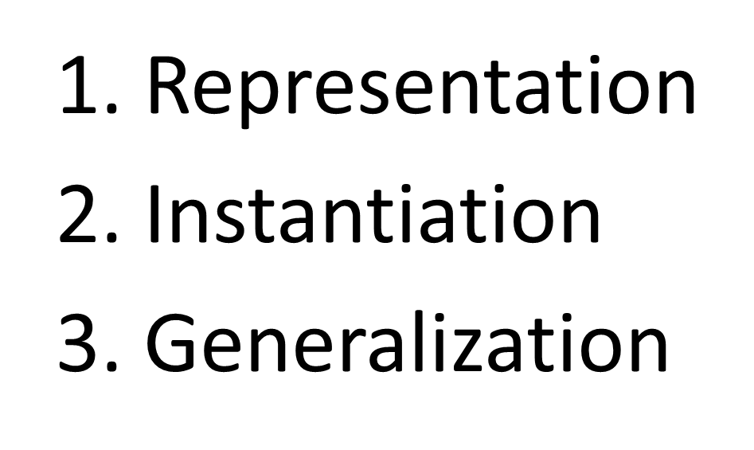
Data Structure Invariants
Piggyback Predicates On Types

Slide 61
Representation
[]
::
{x:int|0<x} list
int list
x:int
Describes all elements
0<x

Slide 62
Type Unfolding
[]
[]
[]
::
::
::
x:int
x:int
h:int
0<x
0<x
0<h
Empty
Head
Tail
List of positive integers
Positive
Property holds recursively

Slide 63
Representation
x<v
v Describes tail elements
[]
::
x:int
0<x
Describes all elements

Slide 64
Type Unfolding
h<v
x<v
x<v
[]
[]
[]
::
::
::
x:int
x:int
h:int
h<x
Empty
Head
Tail
Push Edge Predicate Into Node
Rename Variable
List of sorted integers
Elements larger than head
Property holds recursively

Slide 65
Piggyback Predicates on Type
Representation
Instantiation
Generalization

Slide 66
Height Balanced Tree
Height
tree
l
r
Node
|Hl–Hr|<2
Leaf
measure H =
| Leaf = 0
| Node(x,l,r) = 1 + max (H l) (H r)
H l = Left subtree’s height
H r = Right subtree’s height
l = Left subtree
r = Right subtree
Height difference bounded at each node

Slide 67
Data Structure Invariants
Piggyback Predicates On Types

Slide 68
Quantifier Instantiation
x<V
x<V
[]
::
::
[]
::
Unfold
x:int
h:int
x:int
l
t
h<x
match l with h::t
l:sorted list
h:int
t:sorted list
& {h<x} list
Instantiate
Notes:
Why does the font change here vs the types one? It seems more jarring than a cue
Rename to h rather x_1, x_2…
Low-rder: Say we refer to blah as sorted to make it clear?

Slide 69
Data Structure Invariants
Piggyback Predicates On Types

Slide 70
Quantifier Generalization
x<V
x<V
[]
::
::
[]
::
Fold
x:int
h:int
x:int
l
t
h<x
let l = h::t in
l:sorted list
h:int
t:sorted list
& {h<x} list
Generalize

Slide 71
Liquid Types
Automatic
Automatic Liquid Type Inference
By Predicate Abstraction
Expressive

Slide 72
Automatic Liquid Type Inference
Complex Subtyping
Between data types
X₂
x<v
[]
::
Reduces To Simple Implications
Between X₁, X₂, ...
x:int
X₁
0<x
Let X₁, X₂, ... = Unknown Predicates
Predicates Determine Invariant
Solved by Predicate Abstraction
Over atoms 0<x, x<v, ...

Slide 73
Demo

Slide 74
Results
C or ML
+ Asserts
Dsolve
Safe+Types
Atoms
Error+Types

Slide 75
Program (ML) | Verified Invariants
List-based Sorting | Sorted, Outputs Permutation of Input
Finite Map | Balance, BST, Implements a Set
Red-Black Trees | Balance, BST, Color
Stablesort | Sorted
Extensible Vectors | Balance, Bounds Checking, …
Binary Heaps | Heap, Returns Min, Implements Set
Splay Heaps | BST, Returns Min, Implements Set
Malloc | Used and Free Lists Are Accurate
BDDs | Variable Order
Union Find | Acyclicity
Bitvector Unification | Acyclicity

Slide 76
Memory Safety of C Programs
Program (C) | Lines | Data Structures Used
stringlists | 72 | Arrays, Linked Lists
strcpy | 77 | Arrays
adpcm | 198 | Arrays
pagemap | 250 | Arrays, Linked Lists
mst | 309 | Arrays, Linked Lists, Graphs
power | 620 | Arrays, Linked Lists, Graphs
ks | 650 | Arrays, Linked Lists
ft | 742 | Arrays, Graphs
Verified Property
Spatial Memory Safety
No Buffer Overflows
No Null Dereferences

Slide 77
Take Home Lessons
Why is checking SW hard?
Quantified invariants
How to avoid quantifiers?
Factor invariant into liquid type
How to compute liquid type?
SMT + Predicate Abstraction

Slide 78
Much Work Remains…
“Back-End” Logic
Constraint Solving
Rich Decidable Logics
Qualifier Discovery…

Slide 79
Much Work Remains…
“Front-End” Types
Destructive Update
Concurrency
Objects & Classes
Dynamic Languages…

Slide 80
Much Work Remains…
User Interface
The smarter your analysis,
the harder to tell why it fails!

Slide 81
http://goto.ucsd.edu/liquid
source, papers, demo, etc.

Slide 82
Finite Maps (ML)
5: ‘cat’
3: ‘cow’
8: ‘tic’
From Ocaml Standard Library
1: ‘doc’
4: ‘hog’
7: ‘ant’
9: ‘emu’
Verified Invariants
Binary Search Ordered
Height Balanced
Keys Implement Set
Implemented as AVL Trees
Rotate/Rebalance on Insert/Delete

Slide 83
Binary Decision Diagrams (ML)
X₁
X₂
X₂
X₃
Graph-Based Boolean Formulas [Bryant 86]
X₄
X₄
1
Efficient Formula Manipulation
Memoizing Results on Subformulas
Verified Invariant
Variables Ordered Along Each Path
X₁⇔X₂ ∧ X₃⇔X₄

Slide 84
Vec: Extensible Arrays (317 LOC)
“Python-style” extensible arrays for Ocaml
find, insert, delete, join etc.
Efficiency via balanced trees
Balanced
Height difference between siblings ≤ 2
Dsolve found balance violation

Slide 85
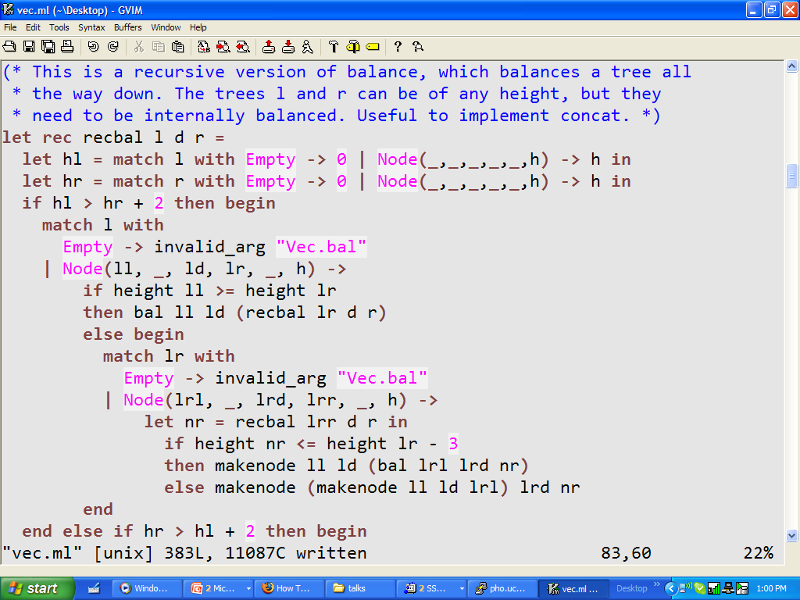
Recursive Rebalance
fatal off-by-one error

Slide 86
Debugging via Inference
Using Dsolve we found
Where imbalance occurred
(specific path conditions)
How imbalance occurred
(left tree off by up to 4)
Leading to test and fix

